Slide 1




Unified Code for Collocation Multistep Methods in Solving Systems of Ordinary Differential Equations
OKWHAROBO, Solomon Monday
Supervised by: Prof J.O Fatokun

Slide 2
Table of Contents
01 - Introduction
05 – Literature review
02 - Aim & Objectives
06 - Methodology
03 - Abstract
07 – Numerical results
04 – Problem Statement
08 - Conclusion

Slide 3
1
Introduction

Slide 4
Background of Study
Mathematical models in various disciplines often use ordinary differential equations (ODEs) to describe how quantities change.
ODEs provide a way to capture the rate of change of variables, essential for understanding dynamic processes.
Analytical solutions to ODEs are often difficult or impossible to obtain, highlighting the need for Numerical methods.
Numerical techniques like implicit methods, exponential integrators, and collocation multistep methods are crucial for solving stiff systems of ODEs.

Slide 5
Definition of Terms
Ordinary Differential Equation (ODE): An equation involving an unknown function and its derivatives.
Numerical Method: A technique for approximating solutions to ODEs using discrete steps.
Stiff System: A system with components that vary widely in natural frequencies or time scales.
Linear Multistep Method (LMM): A numerical method using multiple previous function values for approximation. Stability, Convergence, and Order of Accuracy: Properties indicating the behavior and accuracy of numerical methods.

Slide 6
Significance of Study
Enhances theoretical understanding of LMMs and their numerical properties.
Provides valuable tools for accurate and efficient solutions of ODEs.
Advances computational techniques for research, design, and decision-making processes.

Slide 7
Scope of Study
The Analysis of the General Linear Multistep Methods (Adams-Bashforth, Adams-Moulton, Backward Differential Formula) for solving ODEs.
Investigate stability, accuracy, and convergence of these methods for stiff ODEs.
Develop a user-friendly software tool for the Mathematical analysis of LMM, including parameter tuning and result visualization.

Slide 8
2
Aims & Objectives

Slide 9
Aims
The aim of the project is to develop a robust software tool for analyzing linear multistep methods used in solving systems of ordinary differential equations (ODEs)-both stiff and non-stiff cases and use the method to solve problems of ordinary differential equations (ODEs).

Slide 10
Objectives of Study
Algorithm Development and Software Implementation
Validation and Error Analysis
Optimization and Documentation

Slide 11
3
Problem Statement

Slide 12
Problem Statement
No numerical solver effectively balances accuracy, stability, and computational efficiency while analyzing Linear Multistep Methods (LMM).
There is a need for a robust solver that can effectively handle both non-stiff and stiff problems while providing reliable and precise results.

Slide 13
Problem Statement
Can we streamline the computational analysis of Linear Multistep Methods (LMM) to reduce time and enhance efficiency?

Slide 14
4
Literature Review

Slide 15
Title | Author | Summary | Limitation
Chebyshev collocation methods for ordinary differential equations | K. Wright | The paper describes some properties and advantages of these methods, which use finite Chebyshev series to approximate the solution and satisfy the ODE at certain points within the range. | -No multistep method discussed - Not implemented in code
A Numerical Algorithm for Solving Stiff Ordinary Differential Equations | S. A. M. Yatim,¹Z. B. Ibrahim,²K. I. Othman,³and M. B. Suleiman² | The paper compares the performance of the VSVO-BBDF method with MATLAB’s ode15s and ode23s solvers on three test problems arising from physics | -Limited to IVPs
Super implicit multistep collocation methods for nonlinear Volterra integral equations | S. Fazeli, G. Hojjati, S. Shahmorad | construct a new class of multistep collocation methods for solving two types of nonlinear Volterra integral equations including non-stiff and stiff problems. | Limited to VIPs
VODE | L.R. Petzold | General-purpose ODE solver. Combines Adams methods and BDF methods for both stiff and non-stiff problems. | Explicit methods can be less efficient for very stiff systems compared to implicit methods.
RADAU5 | H.A. Luther | Implicit Runge-Kutta methods for stiff ODEs. Provides high accuracy and stability for stiff problems. | Can be computationally expensive for large systems due to the use of implicit methods.

Slide 16
5
Methodology

Slide 17
5
Methodology
Development of software

Slide 18




Software Tools
Dart
Flutter
Visual Studio Code
Visual Studio

Slide 19
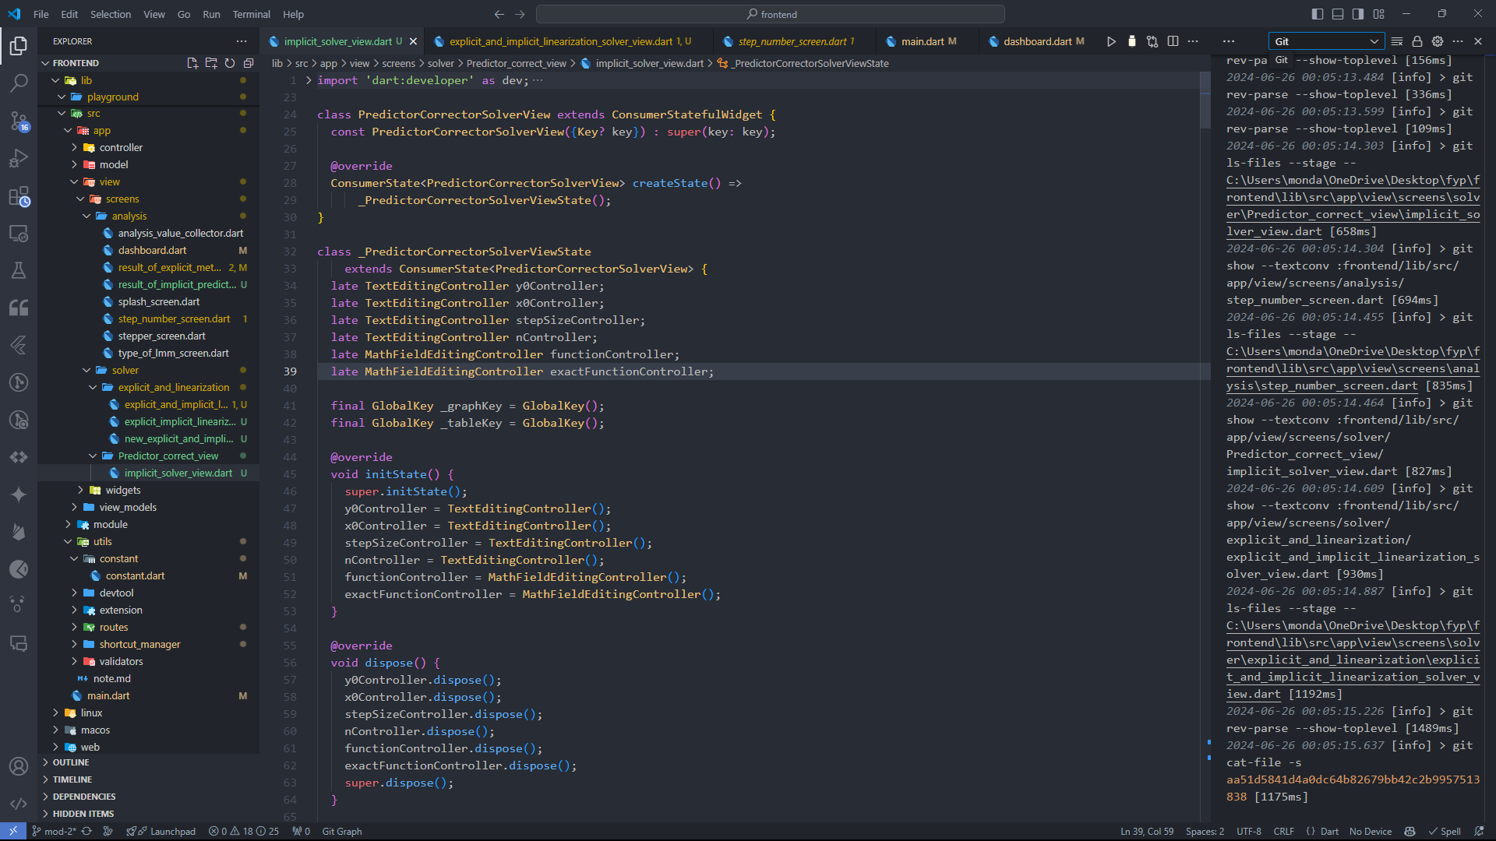
Notes:
Durand-Kerner : This method is capable of calculating all the roots of the polynomial simultaneously.

Slide 20
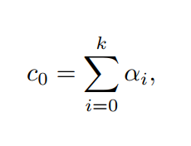
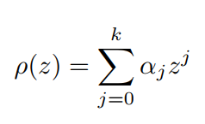
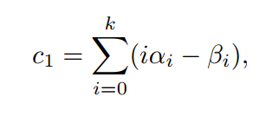
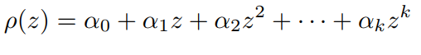
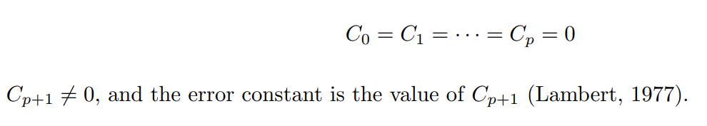
Analysis of GLMM
Consistency
Zero Stability
Convergence
Order and Error Constant
Notes:
Consistency: A consistent LMM has a local truncation error (LTE) that tends to zero as the step size decreases.
This property ensures that numerical approximations are close to the exact solutions.
Zero stability is crucial because it indicates that the method can handle small perturbations and numerical errors without amplifying them excessively.
The order of the a given LMM tells us how quickly the truncation error tends to zero as h → 0

Slide 21
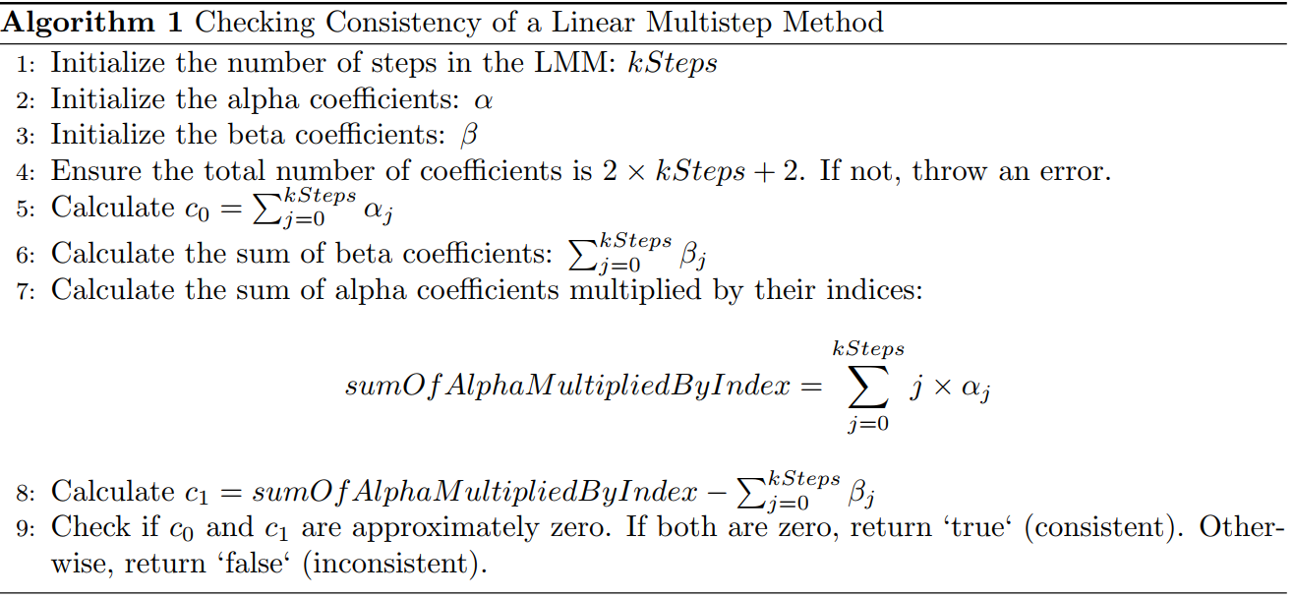
Consistency Analysis Algorithm

Slide 22
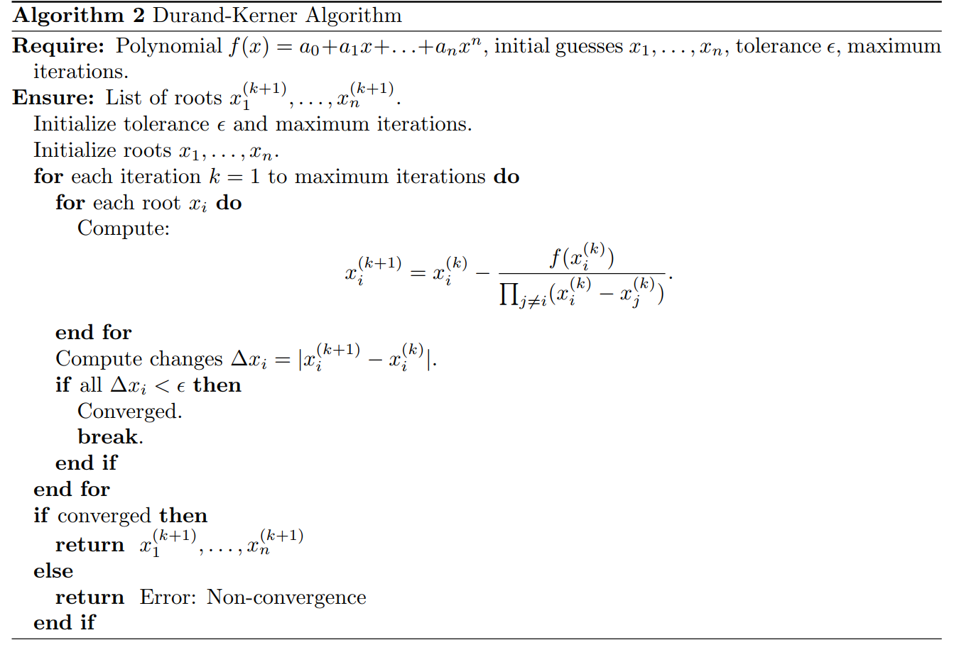
Zero-Stability Analysis Algorithm
Notes:
Durand-Kerner : This method is capable of calculating all the roots of the polynomial simultaneously.

Slide 23
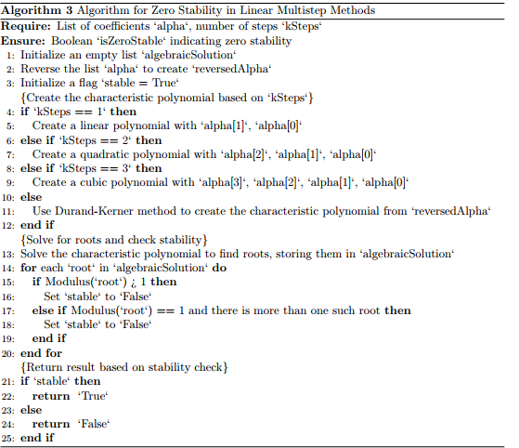
Zero-Stability Analysis Algorithm
Notes:
Durand-Kerner : This method is capable of calculating all the roots of the polynomial simultaneously.

Slide 24
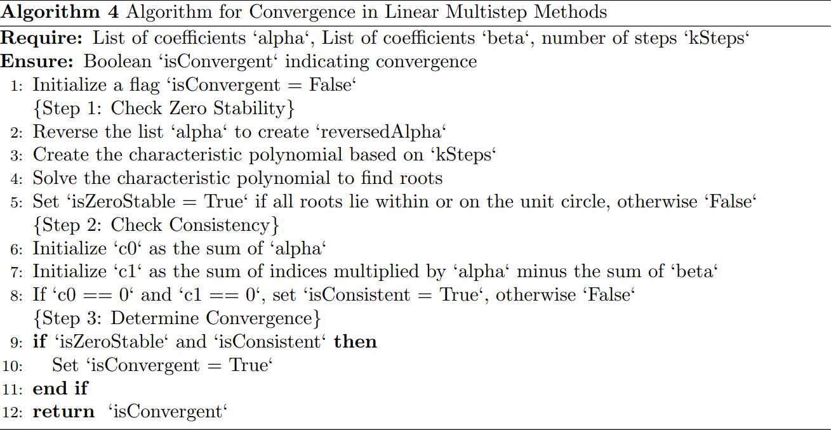
Convergence Analysis Algorithm
Notes:
Durand-Kerner : This method is capable of calculating all the roots of the polynomial simultaneously.

Slide 25
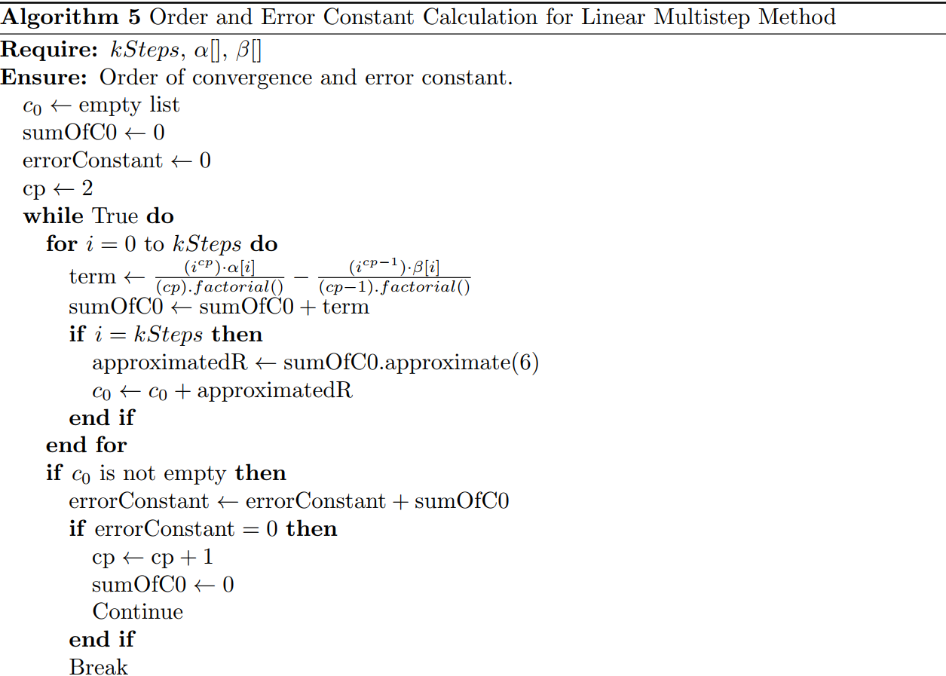
Order and Error Constant
Notes:
Durand-Kerner : This method is capable of calculating all the roots of the polynomial simultaneously.

Slide 26
5
Methodology
Existing Software and Algorithms for LMM

Slide 27
Solver | Method Used | UI Interface | Programming Language | Ease of use
JF-SM Solver | Collocation & Multistep | Custom UI | Dart and Flutter (Desktop) | Easy
LMM Calculator | No Solver Implemented | Custom UI | Python(Web) | Easy
GEAR | Implicit Method | Command Line | Fortran | Difficult
Episode | Implicit | Command line | C++ | Moderate
MatLab | Various (No LMM analyzer) | MatLab GUI | MatLaB | High

Slide 28
7
Numerical results

Slide 29
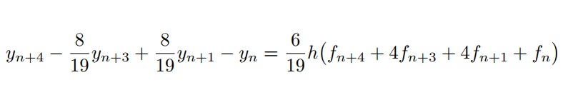
Analysis Module
The Quade’s Method

Slide 30
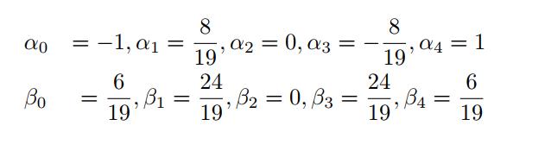
Analysis Module
The Quade’s Method

Slide 31
Analysis Module
The Quade’s Method
Here we apply the JF-MS Solver to determine the
convergence of the four-step Quade’s method, the
order of accuracy, and the error constant.
Thereafter we compare the results with the results
from the study by Emmanuel, 2018)

Slide 32
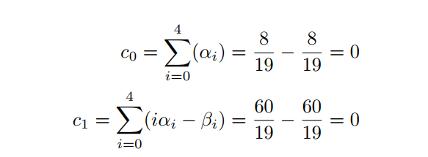
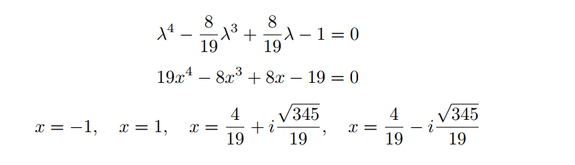
Analysis Module
The Quade’s Method
Consistency:
Zero Stability

Slide 33
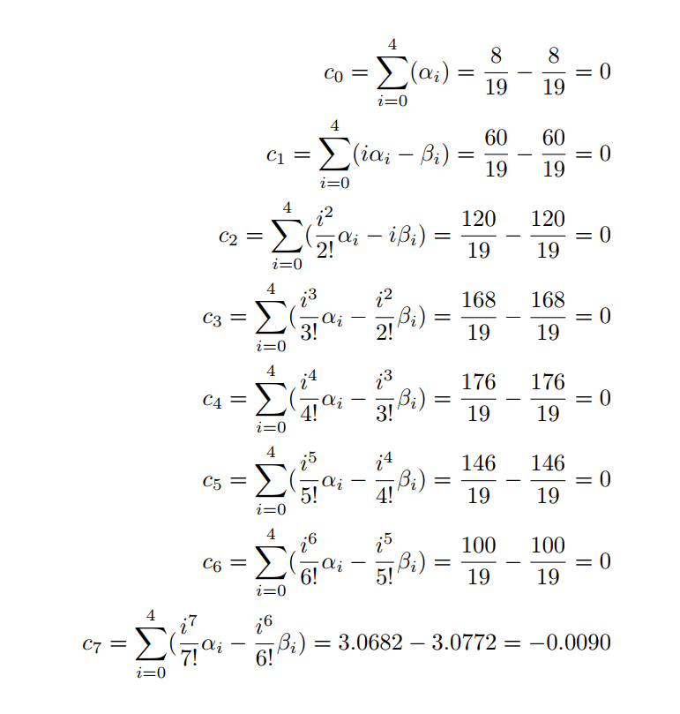
Analysis Module
The Quade’s Method
Complexity of Calculations
1.0
High Order Scheme
Computation Time
2.0
Manual Calculations
Algorithmic Complexity
Error Propagation
3.0
Cumulative Errors
Precision Requirements

Slide 34
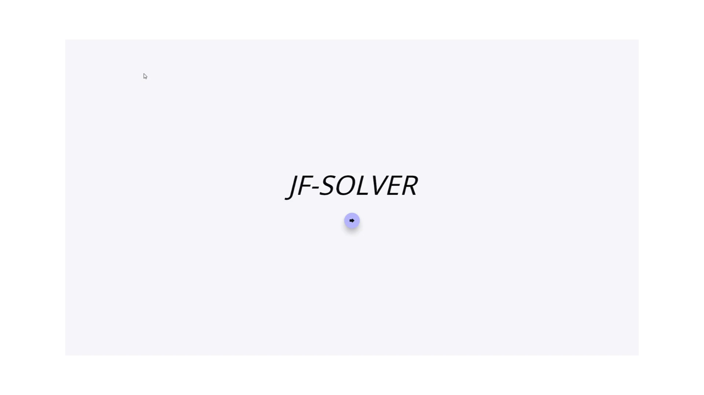
Analysis Module
Using the JFMS-Solver

Slide 35
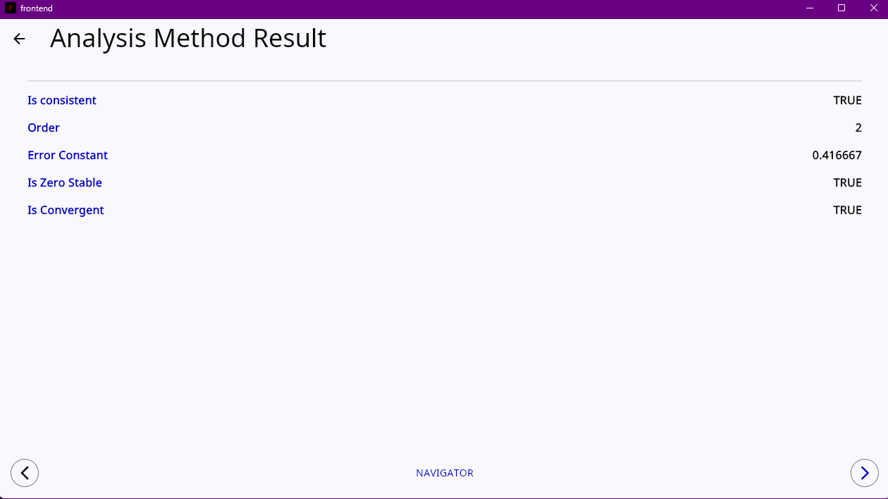
Analysis Module
2-step Adams Bashforth

Slide 36
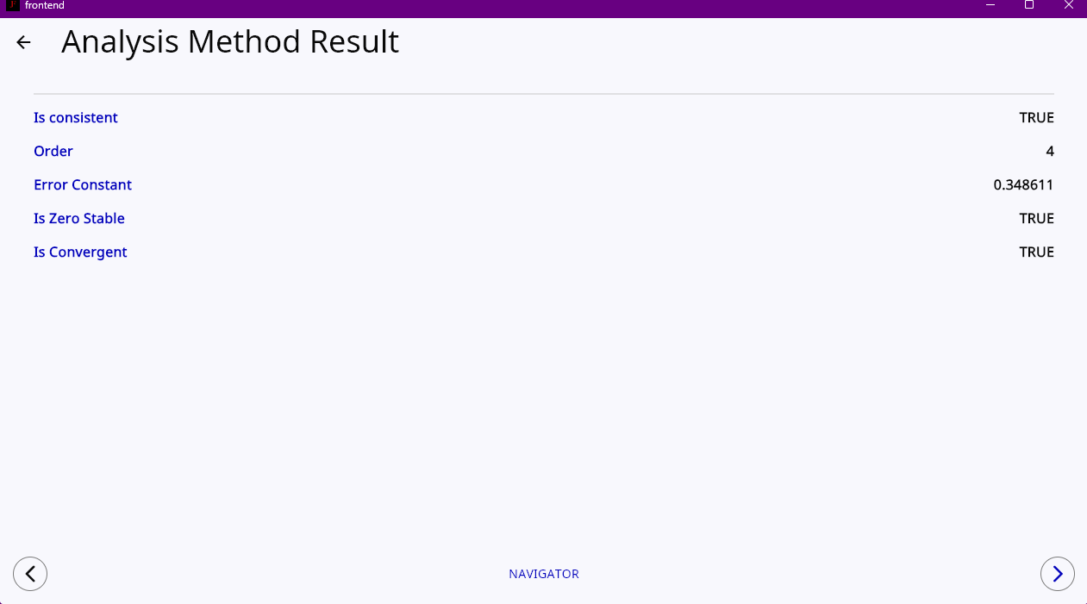
Analysis Module
4-step Adams Bashforth

Slide 37
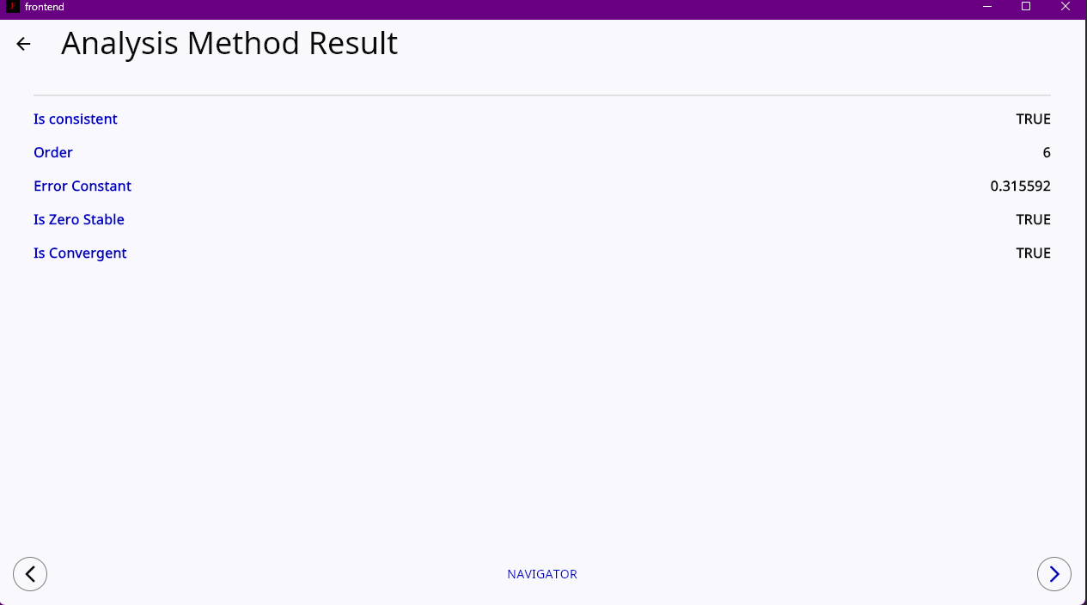
Analysis Module
6-step Adams Bashforth

Slide 38
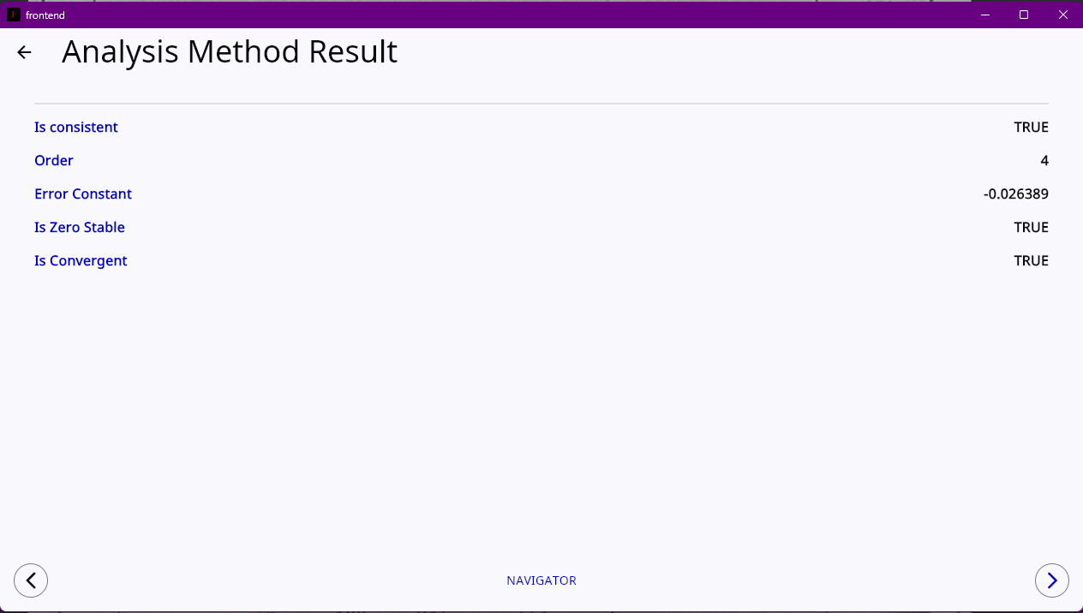
Analysis Module
3-step Adams Moulton

Slide 39
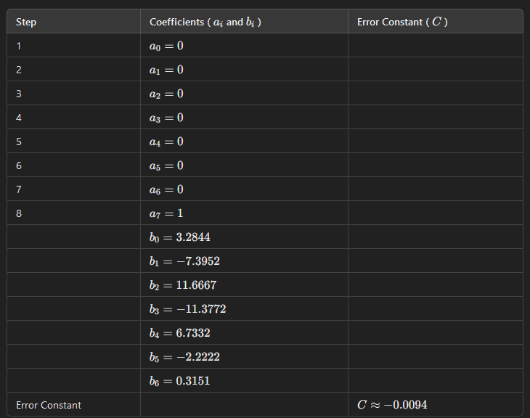
Analysis Module
7-step Adam’s Moulton

Slide 40
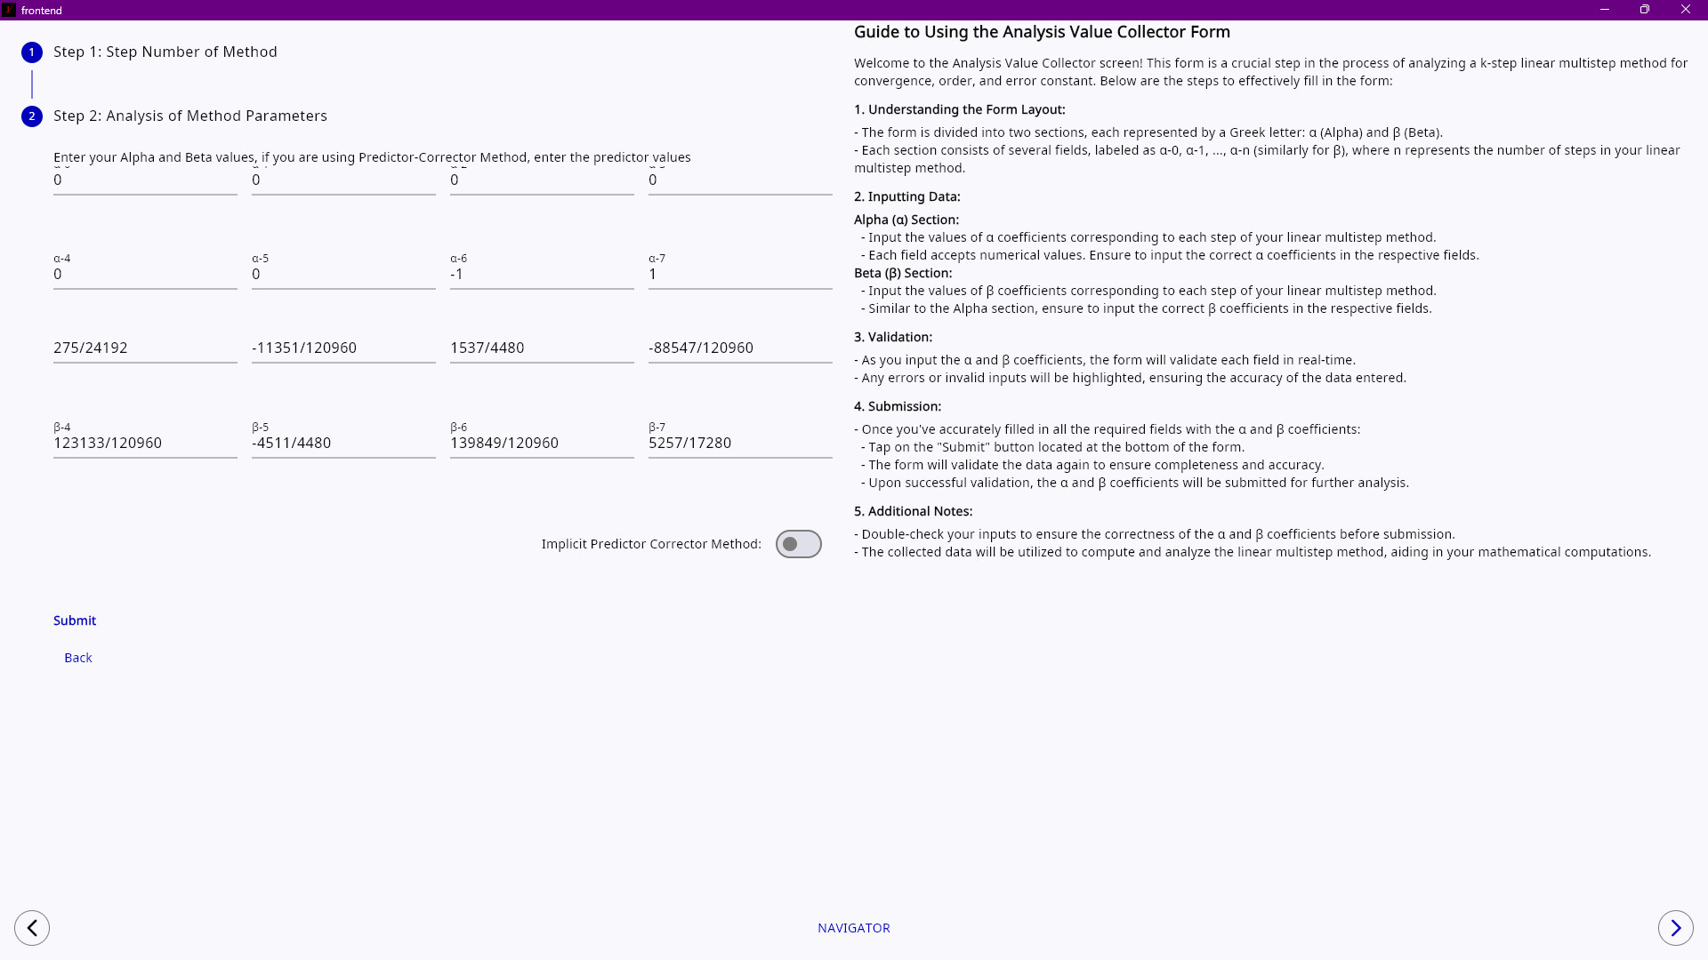
Analysis Module
7-step Adam’s Moulton

Slide 41
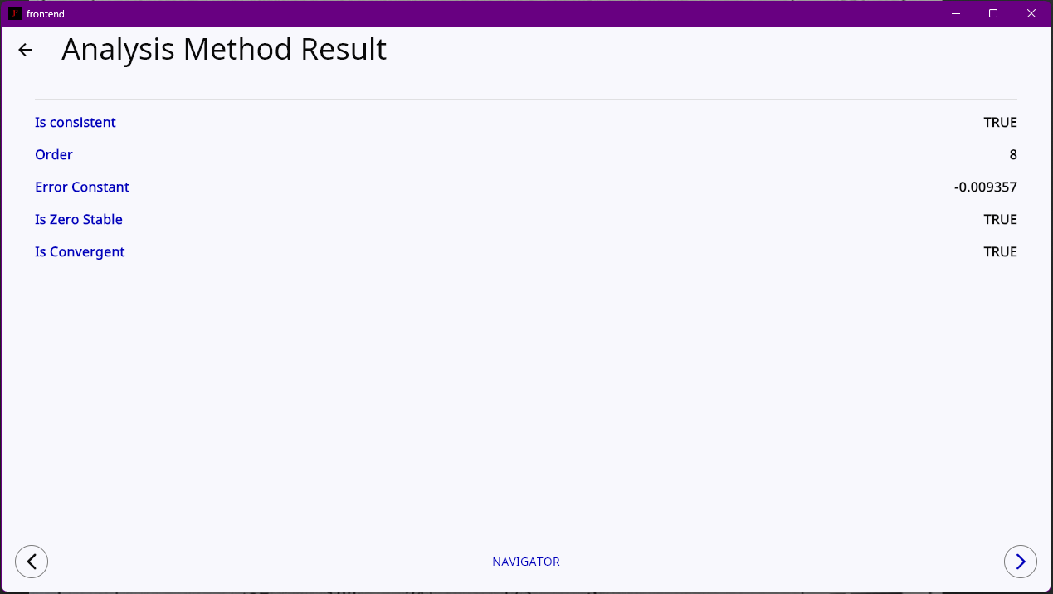
Analysis Module
7-step Adam’s Moulton

Slide 42
Solving Ordinary Differential Equations with JFMS-Solver

Slide 43
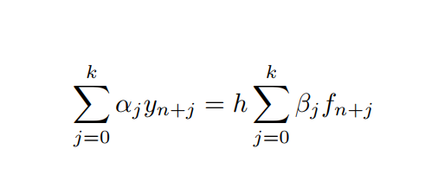
Solutions to ODE
Explicit Solver
Implicit: Linearization Method
Implicit: Predictor-Corrector Method

Slide 44
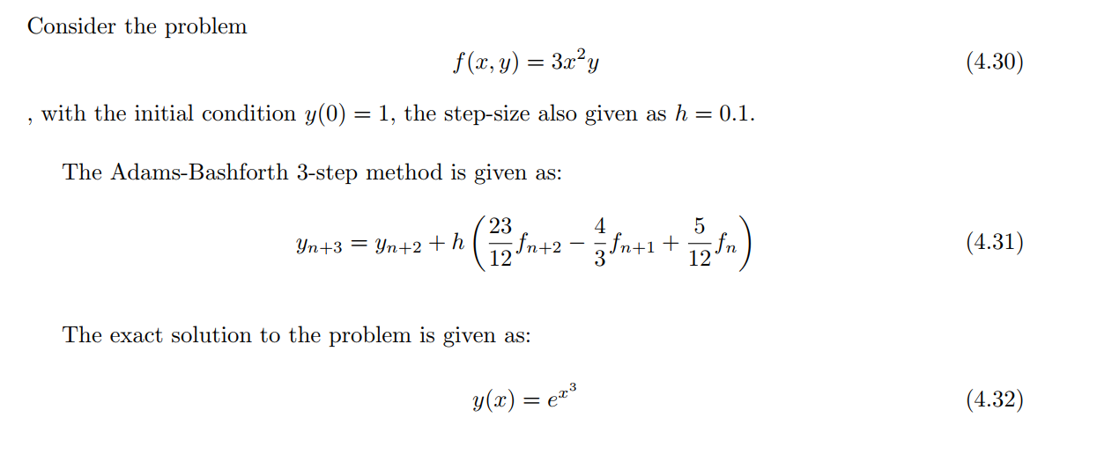
Solver Module
Using the JFMS-Solver

Slide 45
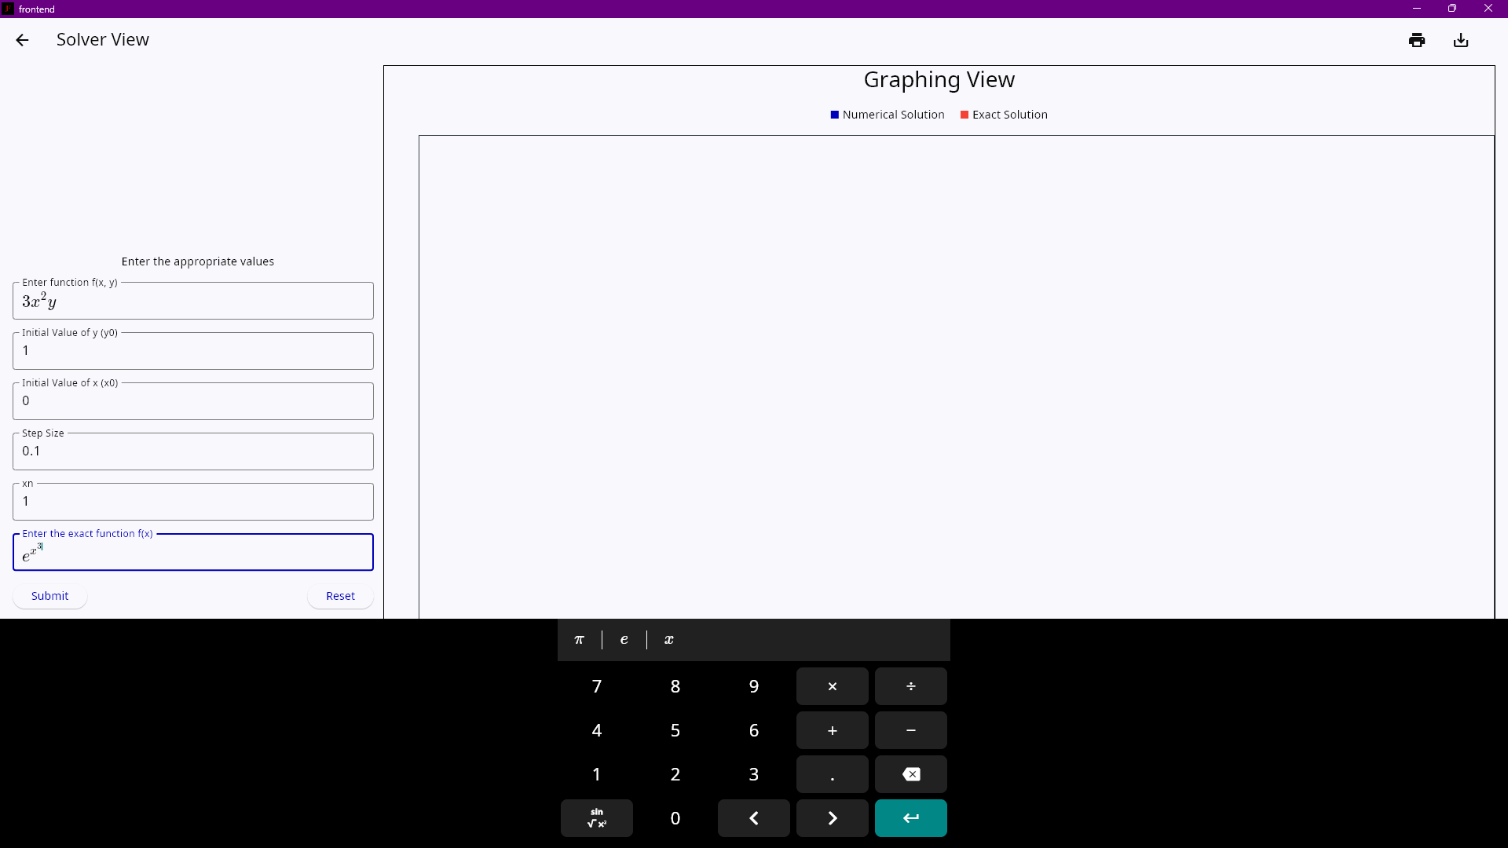
Solver Module
Using the JFMS-Solver

Slide 46
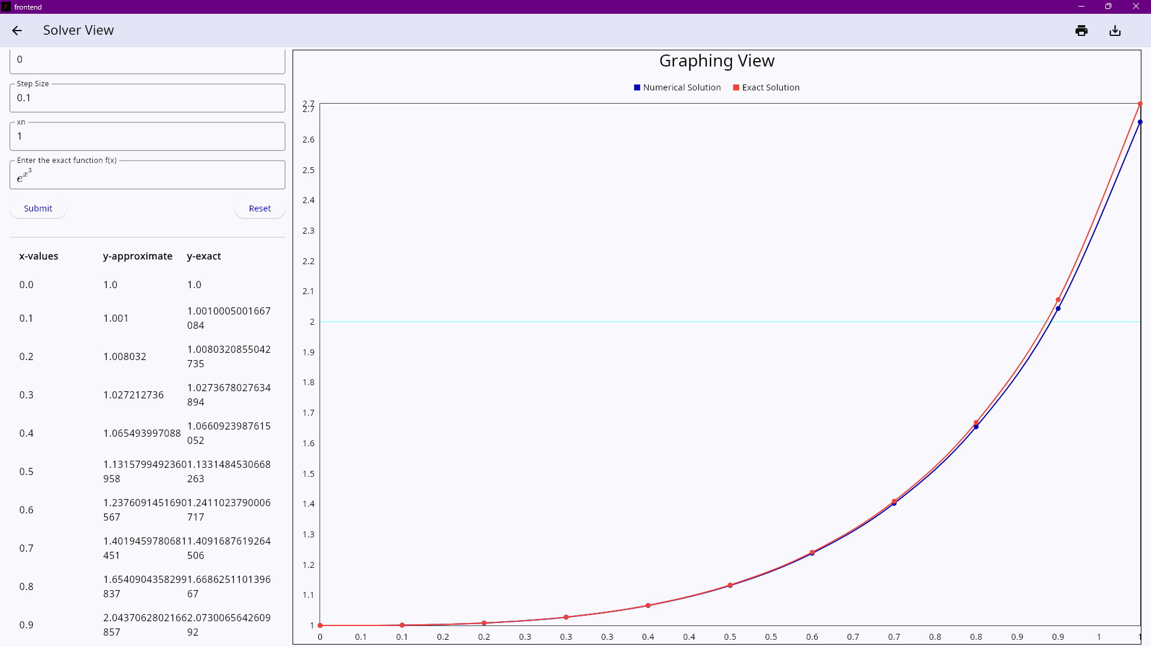
Solver Module
Using the JFMS-Solver

Slide 47
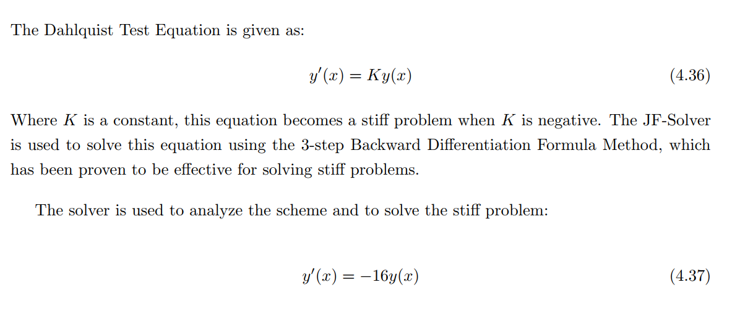
Solver Module
Using the JFMS-Solver

Slide 48
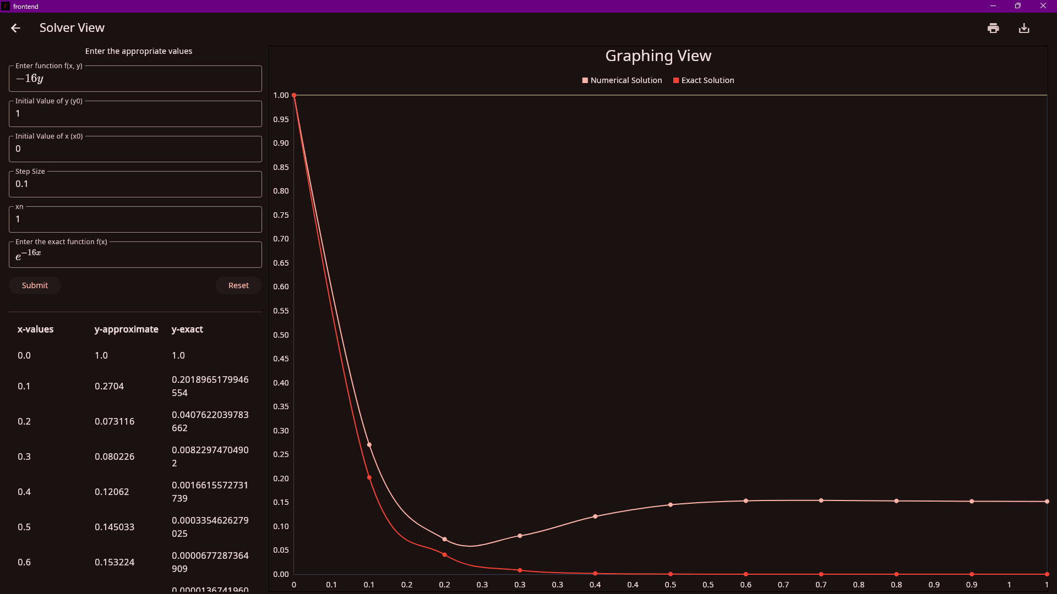
Solver Module
Using the JFMS-Solver

Slide 49
SUMMARY
The aim of this study was to develop, validate, and optimize algorithms for the numerical analysis of linear multistep methods, particularly for solving stiff ordinary differential equations (ODEs).
This was accomplished through a structured approach comprising three main objectives: Algorithm Development and Software Implementation, Validation and Error Analysis, and Optimization and Documentation.

Slide 50
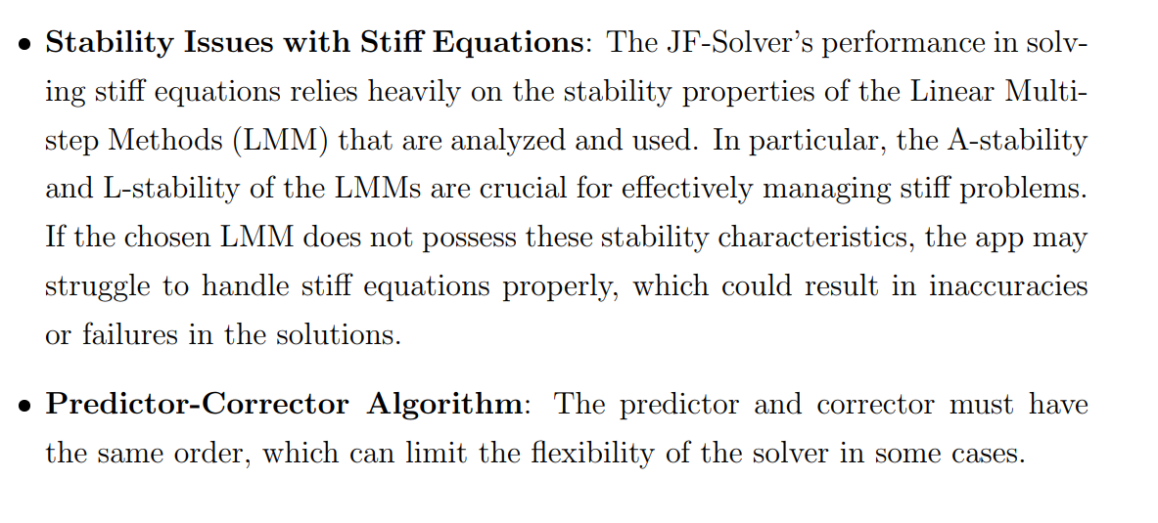
Limitations
Notes:
he ratio of the largest and smallest eigenvalues of

Slide 51
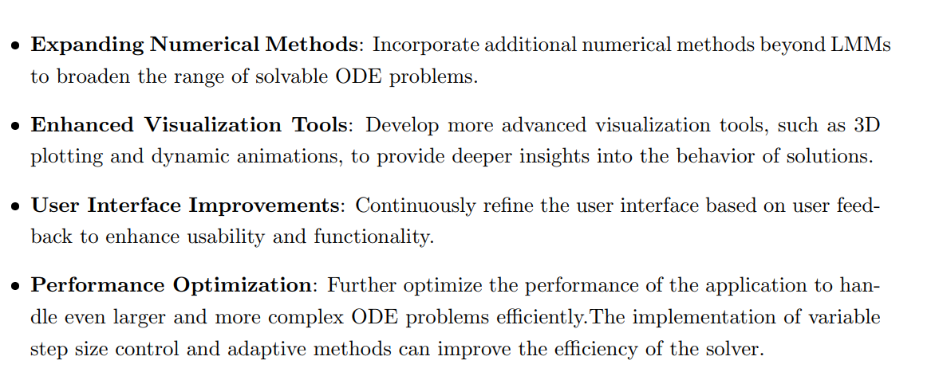
Recommendations

Slide 52
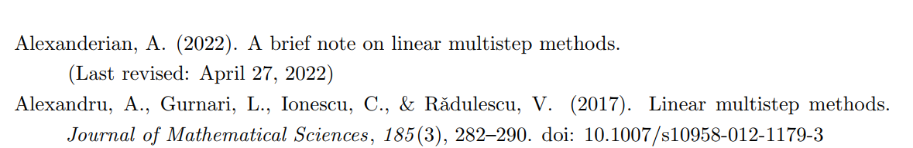
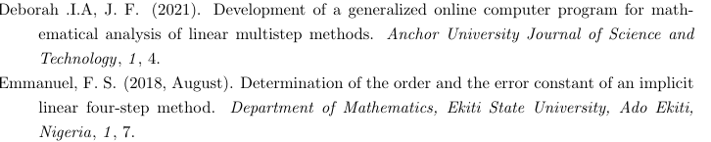
References

Slide 53
THANK YOU!!!
Standby For Questions

